Slide 1
Applied Data Science DATa visualization
Dr. Omri Allouche
2017

Slide 2
Homework
Perform EDA of the OkCupid dataset https://github.com/rudeboybert/JSE_OkCupid
Use Jupyter Notebook, combining markdown, code and graphs
Use appropriate headings and sections
Choose the best graph for the job
Explain what the graph shows
Submit notebook as a Pull Request. Name the file YOURID_YOURNAME_EDA_OkCupid.ipynb
Read Example Machine Learning Notebook until Step 5 (Classification) – not including
Read Visualization with Seaborn

Slide 3
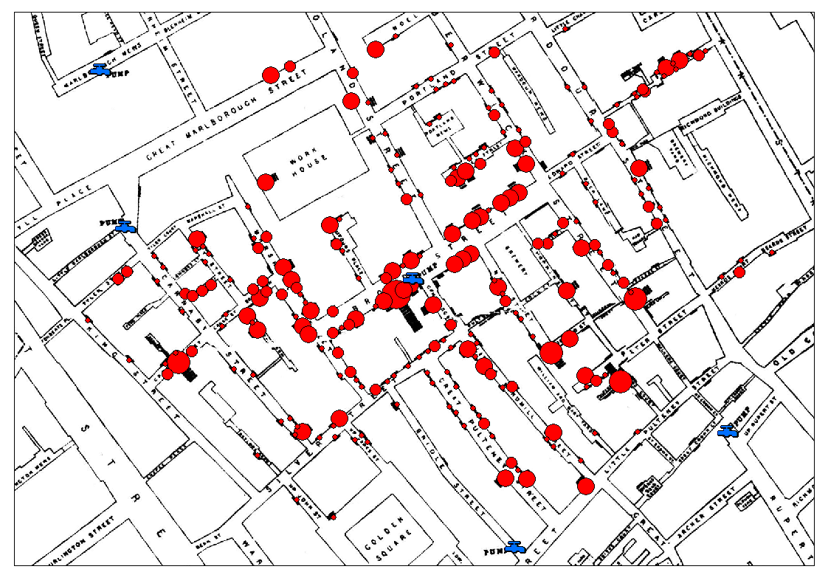
John Snow & The 1854 London Cholera Outbreak

Slide 4
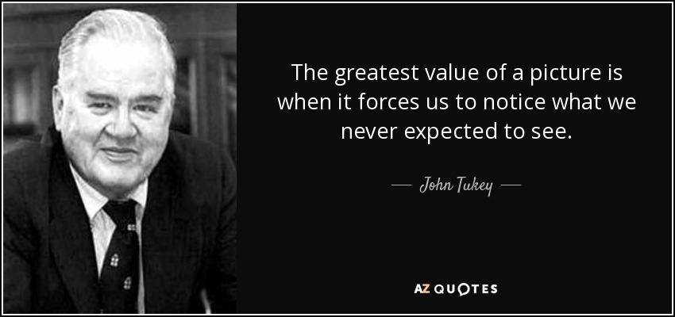

Slide 5
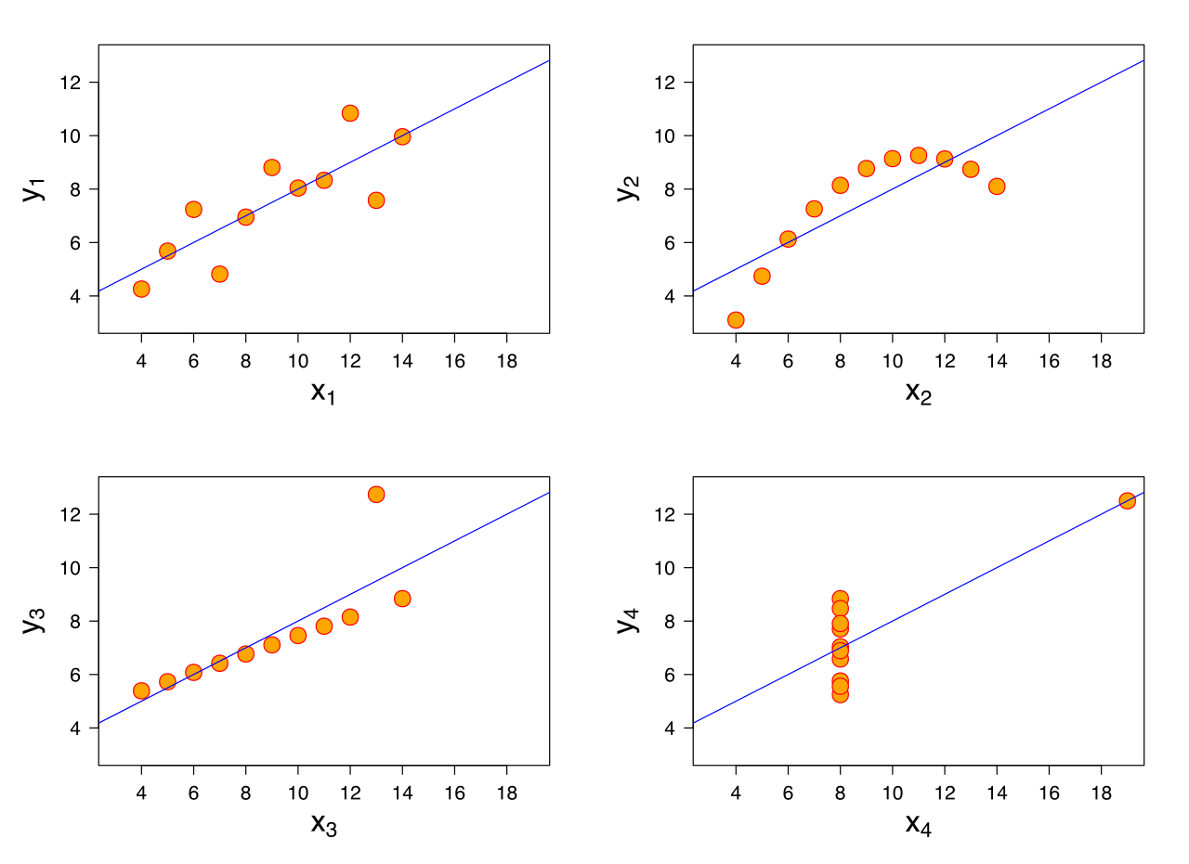
anscombe’s quartet

Slide 6
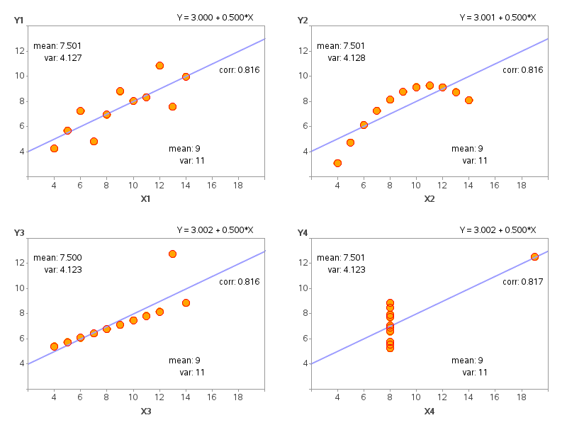
anscombe’s quartet

Slide 7
Data visualization – matplotlib
Review in class of a Jupyter Notebook.

Slide 8
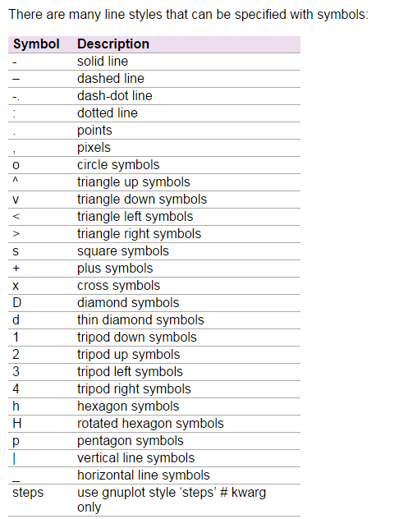
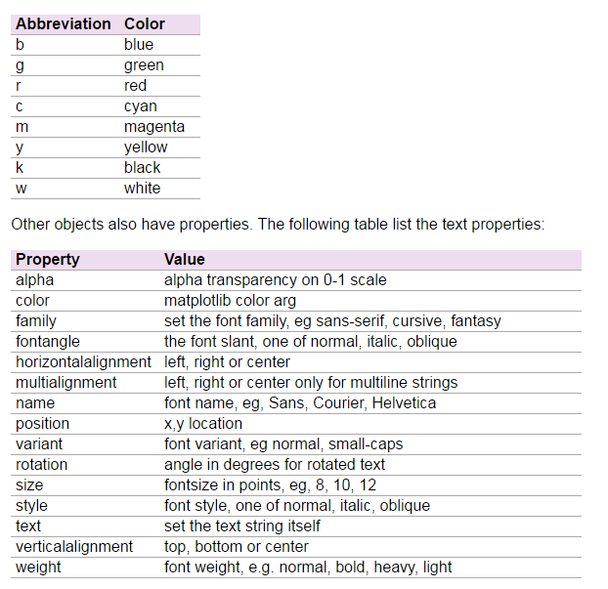

Slide 9
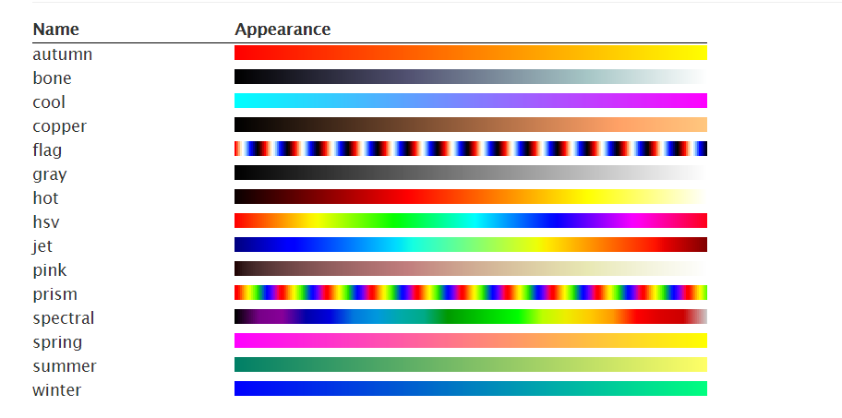
Colormaps
Source: http://www.labri.fr/perso/nrougier/teaching/matplotlib/

Slide 10
additional resource
A very in-depth introduction to Matplotlib:
http://nbviewer.jupyter.org/github/jakevdp/PythonDataScienceHandbook/blob/master/notebooks/04.00-Introduction-To-Matplotlib.ipynb

Slide 11
Univariate Distribution

Slide 12
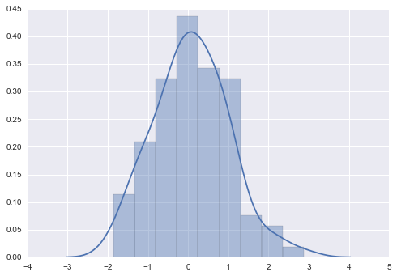
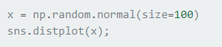
histogram

Slide 13
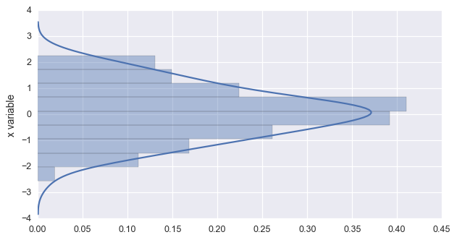
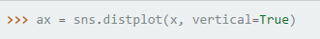
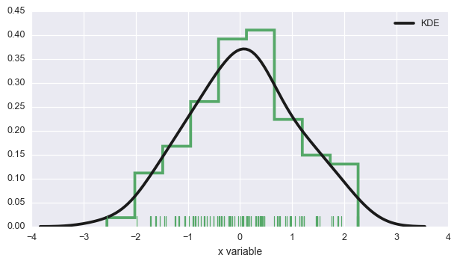
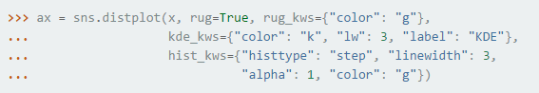
Histogram

Slide 14
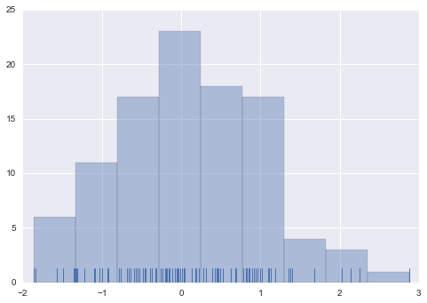
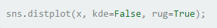
rugplot

Slide 15
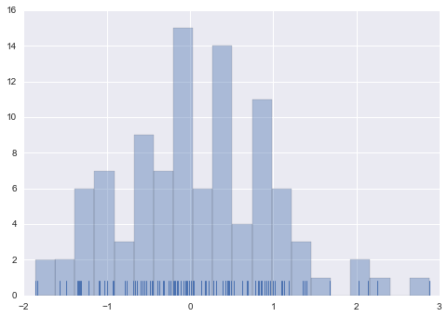
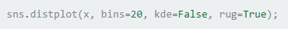
change # of Bins

Slide 16
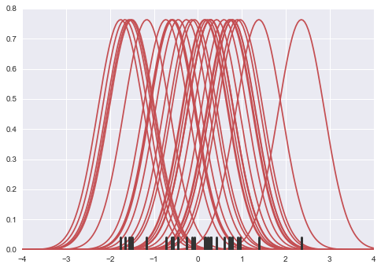
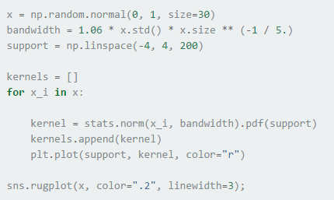
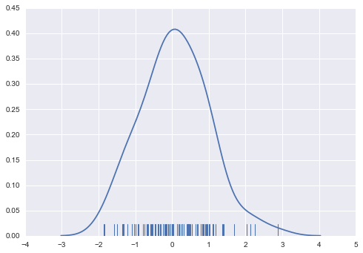
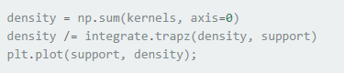
KDE – Kernel Density Estimation

Slide 17
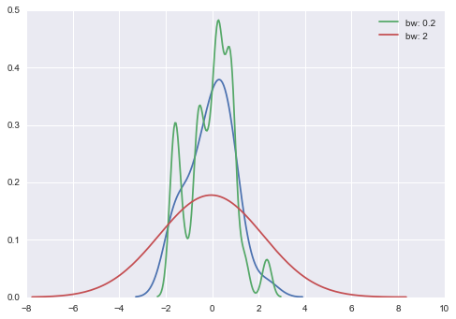
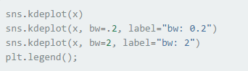
KDE – Change BW

Slide 18
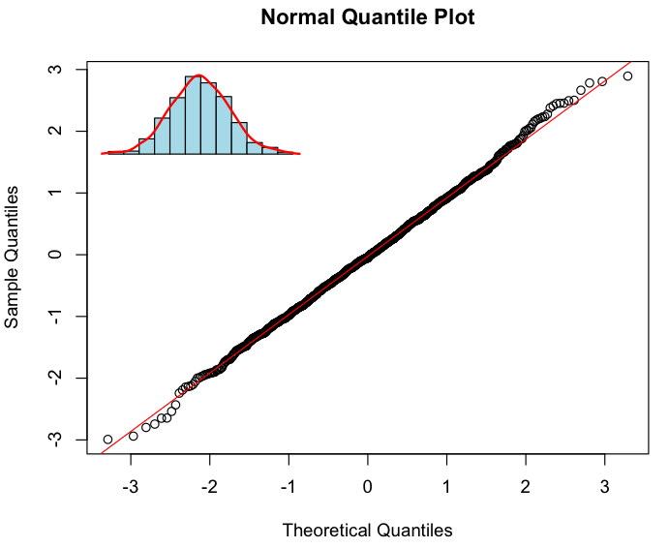
QQ Plot

Slide 19
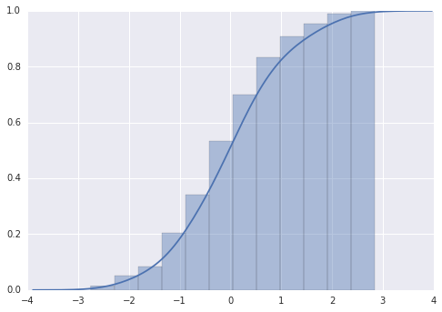
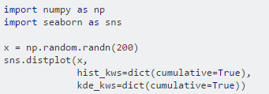
CDF – Cumulative Distribution Function

Slide 20
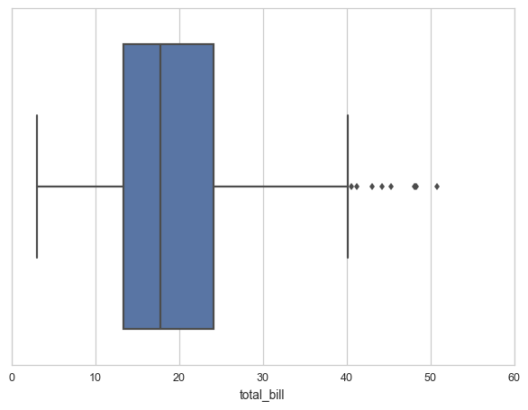
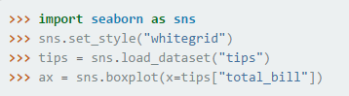
Boxplot
25%
Median
75%
Max OR 150% of IQR
Outliers

Slide 21
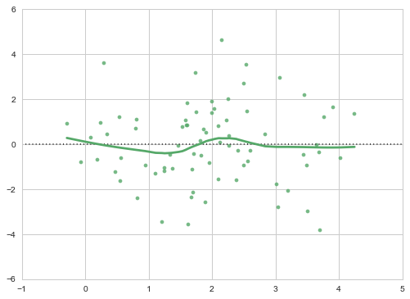
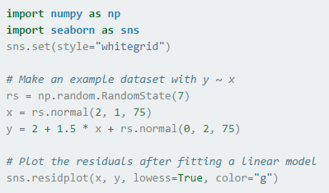
residplot - Residuals

Slide 22
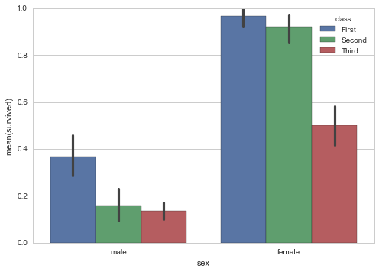
Bar plot

Slide 23
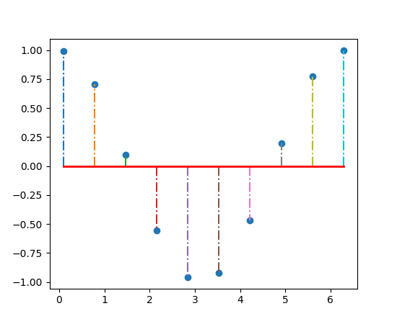
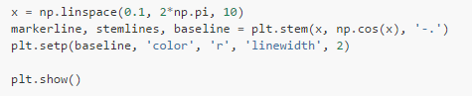
Stem & Leaf

Slide 24
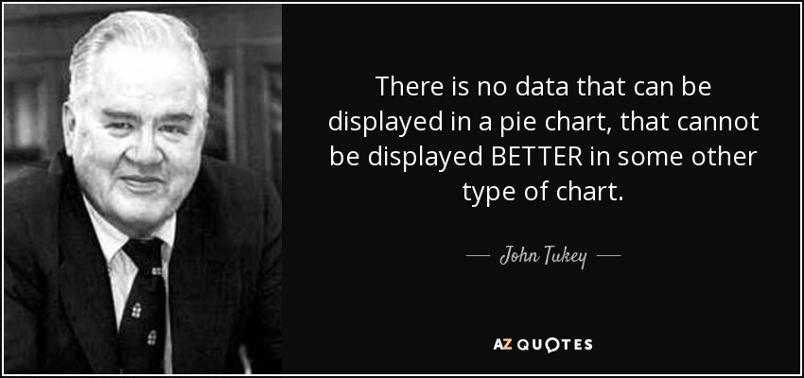
Pie Chart

Slide 25
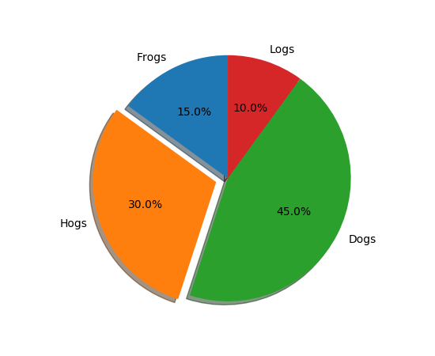
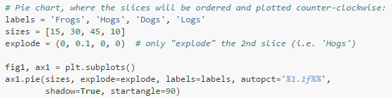
Pie Chart

Slide 26
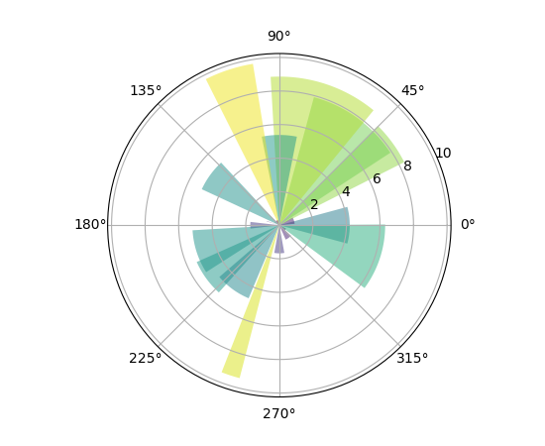
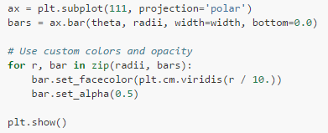
Polar Chart

Slide 27
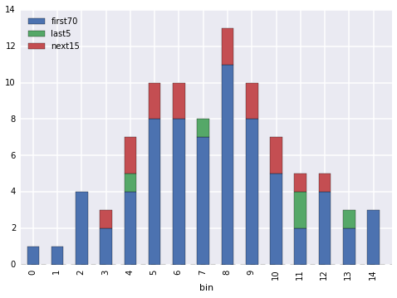
Stacked Bar Plot

Slide 28
Regression

Slide 29
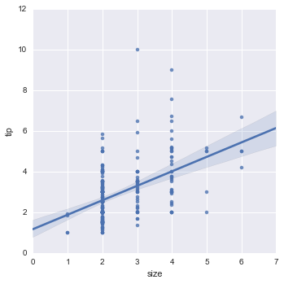
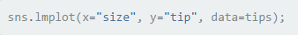
lmplot

Slide 30
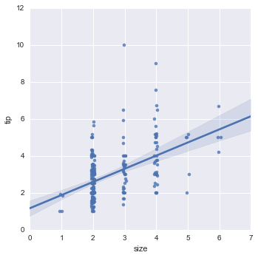
Adding Jitter

Slide 31
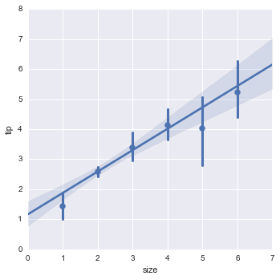
Plot estimator instead of raw points

Slide 32
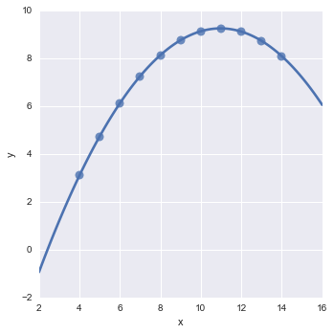
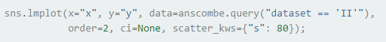
Complex fit models

Slide 33
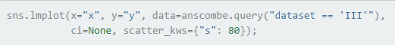
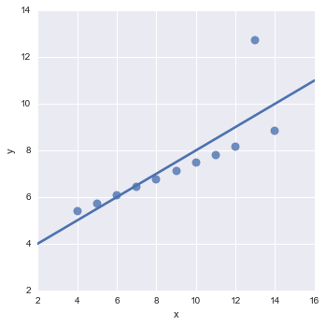
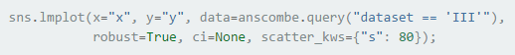
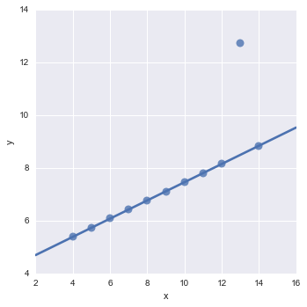

Slide 34
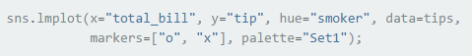

Condition on other variables

Slide 35


Condition As rows and columns

Slide 36
Categorical Plots

Slide 37


Factorplot

Slide 38

Stripplot

Slide 39

Adding Jitter

Slide 40

Swarmplot

Slide 41


Factorplot – 3 categories

Slide 42


Factorplot – Multiple Values

Slide 43


Boxplot

Slide 44


Violinplot
Combines a box plot with KDE

Slide 45


Violinplot

Slide 46


Violinplot with rugs

Slide 47


tsplot – Time Series

Slide 48


Heatmap

Slide 49


Clustermap

Slide 50


Control presentation

Slide 51
BiVariate Distributions

Slide 52


Joint Scatter Plot

Slide 53


Hexbin Plot

Slide 54

KDE

Slide 55


Pair Plot

Slide 56


Pair Plot Variation

Slide 57

Pair plot Variation 2

Slide 58
Data visualization Guidelines

Slide 59
data visualization
Know your audience
Tell a story
Answer the “So what?” question. Have a specific message
Choose the right visualization
Keep it simple. Less is more

Slide 60

Hans Rosling's 200 Countries, 200 Years, 4 Minutes - The Joy of Stats

Slide 61


Maximize the data-to-ink ratio
Use the 5 seconds rule
Prefer 2D over 3D
Prefer grayscale over color

Slide 62


Slide 63

Visual Variables
Source: Data Points

Slide 64

Color Schemes
Source: Data Points

Slide 65
Poor visualization Examples

Slide 66

Source: Jonathan Cohn via Kenneth Field/Cartonerd

Slide 67


Slide 68


Slide 69


Slide 70


Slide 71


Slide 72


Slide 73


Slide 74


Slide 75


Slide 76


Slide 77


Slide 78


Slide 79


Slide 80
Recommended Resource
https://www.youtube.com/watch?v=GIVK0-SNUgU
Mehrdad Yazdani | Using Exploratory Data Analysis to Discover Patterns

